Slide 1
O-P-C-E-B-B I remember like this- Michael Jackson sings-ABC 123 OPCEBB
Organism -> Population-> Community -> Ecosystem -> Biome -> Biosphere

Slide 2
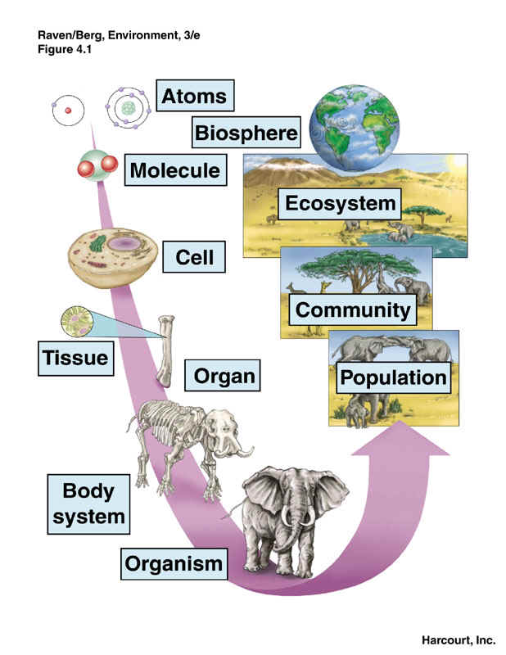

Slide 3
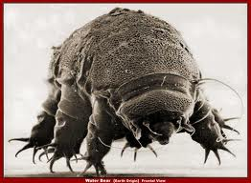
Organism
1 individual living thing
Example: A deer, a duck, a tree

Slide 4
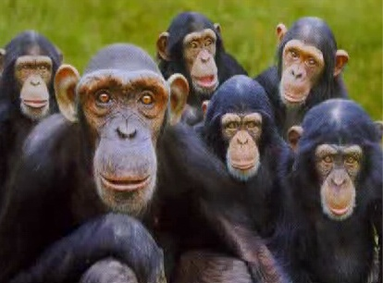
Population
A group of organisms of the same species.
Example a flock of geese, a herd of sheep

Slide 5
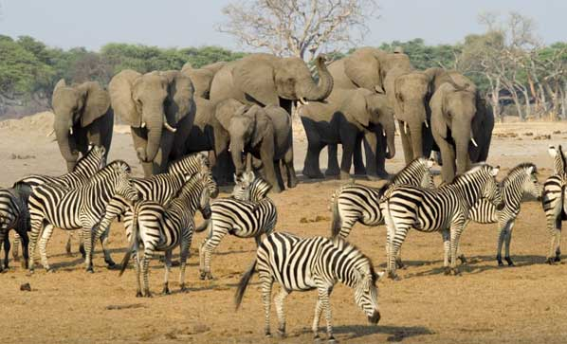
Community
All of the biotic factors in an area.
Including plants and animals.

Slide 6
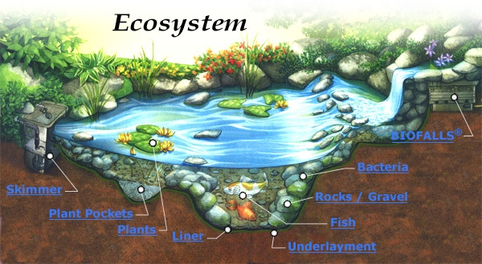
Ecosystem
All of the BIOTIC and ABIOTIC factors of an area. Abiotic factors include air, soil, water, temperature.
Example:
a pond,
a grassland,
a forest

Slide 7
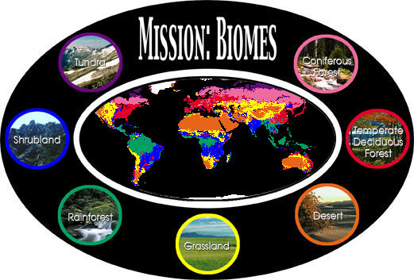
Biome
Several Ecosystems combined, including temperature, rainfall, sunlight, native plants and animals
Bigger area than
An ecosystem
Example tundra
Rainforest, desert

Slide 8
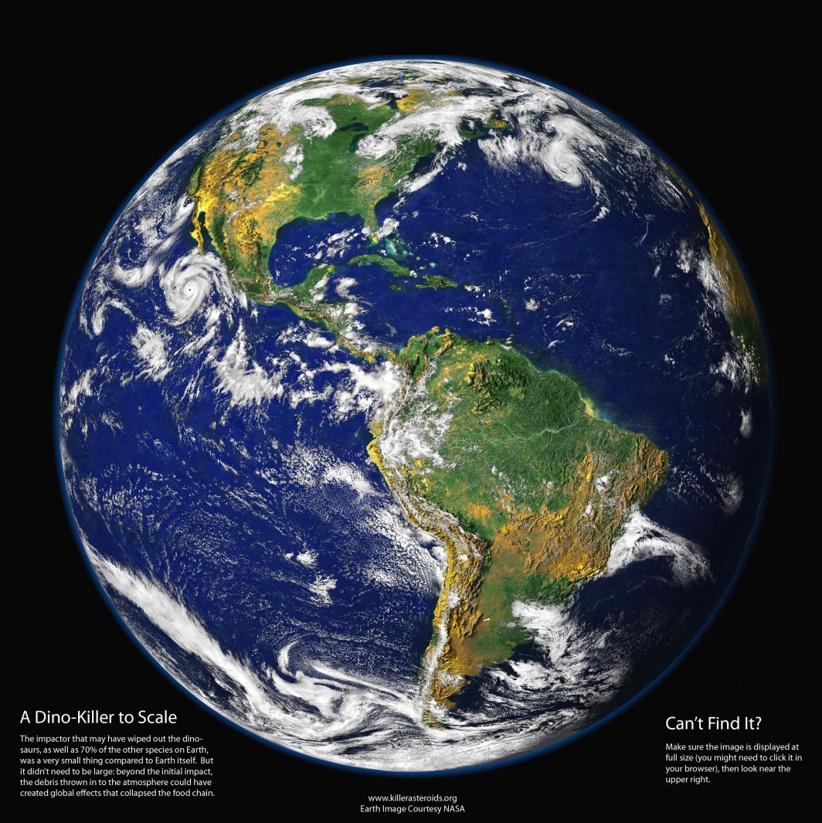
Biosphere
The entire earth, all of the biomes combined

Slide 9
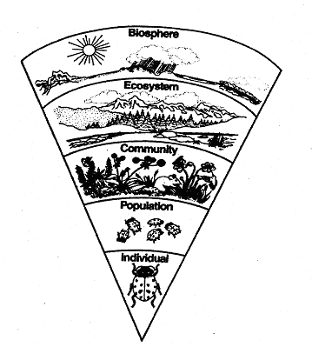

Slide 10
